Slide 1
Information Systems: A Manager’s Guide to Harnessing Technology, V8.0
By John Gallaugher

Slide 2
Strategy and Technology: Concepts and Frameworks for Achieving Success

Slide 3
Learning Objectives
Define operational effectiveness and understand the limitations of technology-based competition leveraging this principle.
Define strategic positioning and the importance of grounding competitive advantage in this concept.
Understand the resource-based view of competitive advantage.
List the four characteristics of a resource that might possibly yield sustainable competitive advantage.

Slide 4
The Danger of Relying on Technology
Firms strive for sustainable competitive advantage.
sustainable competitive advantage: Financial performance that consistently outperforms industry averages.
Difficult to achieve due to the rapid emergence of new products and new competitors.
Competitors cut costs, cut prices, and increase features in order to achieve comparative advantage.
Michael Porter’s concepts are useful for firms attempting to achieve comparative advantage:
Value chain
Five forces

Slide 5
The Danger of Relying on Technology (cont’d)
Porter states that firms defining themselves according to operational effectiveness suffer aggressive, margin-eroding competition.
operational effectiveness: Performing the same tasks better than rivals.
The danger lies in similarity and failure to innovate. When offerings are roughly the same, they are more commodity.
commodity: A basic good that can be interchanged with nearly identical offerings by others.
fast follower problem exists when competitors:
Watch a pioneer’s efforts.
Learn from their successes and missteps.
Enter the market quickly with a comparable or superior product at a lower cost before the first mover can dominate.

Slide 6
The Danger of Relying on Technology (cont’d)
Because technology can be matched quickly, firms that pioneer in technology are especially susceptible to this problem.
strategic positioning: Performing different activities than rivals, or the same activities in a different way.
Technology should create and enable novel business approaches that are defensibly different and can be difficult for others to copy.

Slide 7
Different is Good: FreshDirect Redefines the Grocery Landscape in New York City and Beyond
Technology and Strategic Positioning
The FreshDirect model:
Provides innovations such as:
Worker shifts are highly efficient
Firm buys and prepares its own goods
Higher inventory turns: Number of times inventory is sold or used during a given period.
Use of artificial intelligence and climate-controlled rooms
In exchange, they receive more favorable supplier terms with stores:
Sharing data to improve supplier sales and operations
Paying in days rather than in weeks

Slide 8
But What Kinds of Differences?
resource-based view of competitive advantage: The strategic thinking approach suggesting that if a firm is to maintain sustainable competitive advantage, it must control an exploitable resource, or set of resources, that have four critical characteristics.
Four critical characteristics:
Valuable
Rare
Imperfectly imitable
Nonsubstitutable
Resource-based thinking helps to avoid entering markets simply because growth is spotted.

Slide 9
Learning Objectives
Understand that technology is often critical to enabling competitive advantage, and provide examples of firms that have used technology to organize for sustained competitive advantage.
Understand the value chain concept and be able to examine and compare how various firms organize to bring products and services to market.
Recognize the role technology can play in crafting an imitation-resistant value chain, as well as when technology choice may render potentially strategic assets less effective.

Slide 10
Learning Objectives (cont’d)
Define the following concepts: brand, scale, data and switching cost assets, differentiation, network effects, and distribution channels.
Understand and provide examples of how technology can be used to create or strengthen the resources mentioned above.

Slide 11
Powerful Resources
Being aware of major sources of competitive advantage can help managers:
recognize an organization’s opportunities and vulnerabilities.
brainstorm winning strategies.
Firms with an effective strategic position can create assets that reinforce one another.
This creates advantages that are difficult for rivals to successfully challenge.

Slide 12
Imitation-Resistant Value Chains
imitation-resistant value chain: A way of doing business that competitors struggle to replicate and that involves technology in a key enabling role.
value chain: Set of activities through which a product or service is created and delivered to customers.
For example, elements in FreshDirect’s value chain work together to create and reinforce competitive advantages that others cannot easily copy.

Slide 13
Imitation-Resistant Value Chains (cont’d)
Incumbents would be straddled between two business models, unable to reap full advantages of either.
Late-moving rivals struggle as FreshDirect’s lead time allows it to develop brand, scale, data, and other advantages that newcomers lack.

Slide 14
Key Framework: The Value Chain
Assisted by the secondary elements of:
Firm infrastructure
Human resource management
Technology/research development
Procurement

Slide 15
Key Framework: The Value Chain (cont’d)
Firms may have a critical competitive asset when they have an imitation-resistant value chain.
Value chain framework can be used to consider a firm’s differences and distinctiveness compared to rivals.
Analysis of a firm’s value chain can reveal operational weaknesses.
Technology is of great benefit to improving the speed and quality of execution.

Slide 16
Key Framework: The Value Chain (cont’d)
Firms can buy software and tools:
Supply chain management (SCM)
Customer relationship management (CRM)
Enterprise resource planning software (ERP)
Potential danger: Adopting software that changes a unique process into a generic one.

Slide 17
Brand
brand: The symbolic embodiment of all the information connected with a product or service.
A strong brand can be an exceptionally powerful resource for competitive advantage.
Consumers use brands to decide which company’s products are better, thus forming brand loyalty.
Technology helps in rapidly and cost-effectively strengthening a brand.
viral marketing: Leveraging consumers to promote a product or service.

Slide 18
Scale
scale advantages: Advantages related to size
Businesses benefit from economies of scale: Costs can be spread across increasing units of production or in serving multiple customers.
Organizations are scalable if they benefit from scale economies as they develop.
Developing firms may gain bargaining power with their suppliers or buyers.

Slide 19
Switching Costs and Data
switching costs: Costs incurred by consumers when switching from one product to another.
Firms that seem dominant but that do not have high switching costs can be rapidly outshined by strong rivals.
Sources:
Learning costs
Information and data
Financial commitment
Contractual commitments
Search costs
Loyalty programs

Slide 20
Differentiation
Commodities are products or services that are nearly identically offered from multiple vendors (e.g., gold, wheat).
Consumers who buy commodities focus highly on price since they have so many similar choices.
Technology is used by firms to differentiate their goods and services.
Data plays a critical role in differentiation.

Slide 21
Network Effects
network effects: When the value of a product or service increases as its number of users expands.
Sometimes referred to as network externalities or Metcalfe’s Law.
Switching costs play a role in determining the strength of network effects.
Strong asset for firms that can control and leverage a leading standard.

Slide 22
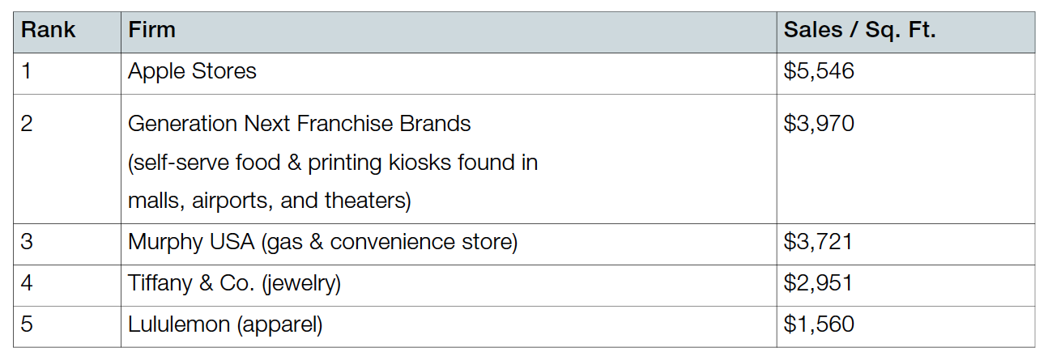
Distribution Channels
distribution channels: The path through which products or services get to customers. This can be critical to a firm’s success.
Through networked technology, users can be recruited to create new distribution channels.
affiliates: Third parties that promote a product or service in exchange for a cut of any sales.

Slide 23
What About Patents?
Protection can be granted in the form of a patent for those innovations deemed to be useful, novel, and nonobvious.
Patents provide firms a degree of protection from copycats.
Cut off paths to exploit an innovation.
Considered to be unfairly stacked against startups.
Non-Practicing Entities: Commonly known as patent trolls, these firms make money by acquiring and asserting patents, rather than bringing products and services to market.

Slide 24
Learning Objectives
Understand the relationship between timing, technology, and the creation of resources for competitive advantage.
Argue effectively when faced with broad generalizations about the importance (or lack of importance) of technology and timing to competitive advantage.
Recognize the difference between low barriers to entry and the prospects for the sustainability of new entrant’s efforts.

Slide 25
Barriers To Entry, Technology, and Timing
Barriers to entry for many tech-centric businesses are low.
Market entry does not necessarily result in building a sustainable business.
Timing and technology alone will not yield sustainable competitive advantage.
Both can be enablers for competitive advantage.
Moving first pays off when the time lead is used to create critical resources that are valuable, rare, tough to imitate, and lack substitutes.

Slide 26
Learning Objectives
Diagram the five forces of competitive advantage.
Apply the framework to an industry, assessing the competitive landscape and the role of technology in influencing the relative power of buyers, suppliers, competitors, and alternatives.

Slide 27
Figure 2.4: The Five Forces of Industry and Competitive Analysis

Slide 28
Key Framework: The Five Forces of Industry Competitive Advantage
The internet can increase buyer power by increasing price transparency in markets where commodity products are sold.
The more differentiated and valuable an offering, the more the Internet shifts bargaining power to sellers.
price transparency: Degree to which complete information is available.
information asymmetry: Decision situation where one party has more or better information than its counterparty.

